Slide 1
Tennessee Promise Application Portal
Click on the “Apply Now” button on www.tnpromise.gov

Slide 2
Tennessee Promise Application Portal
Click “Create a Log in” to create an account.

Slide 3
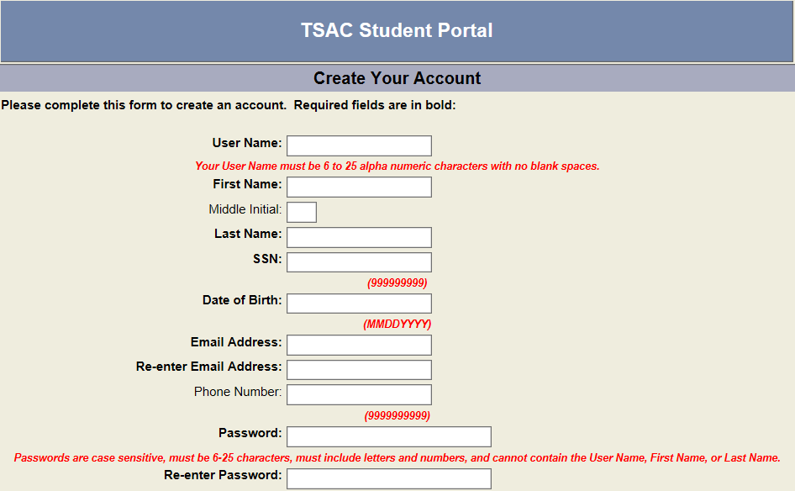
TN Promise Application Process
TSAC Student Portal

Slide 4
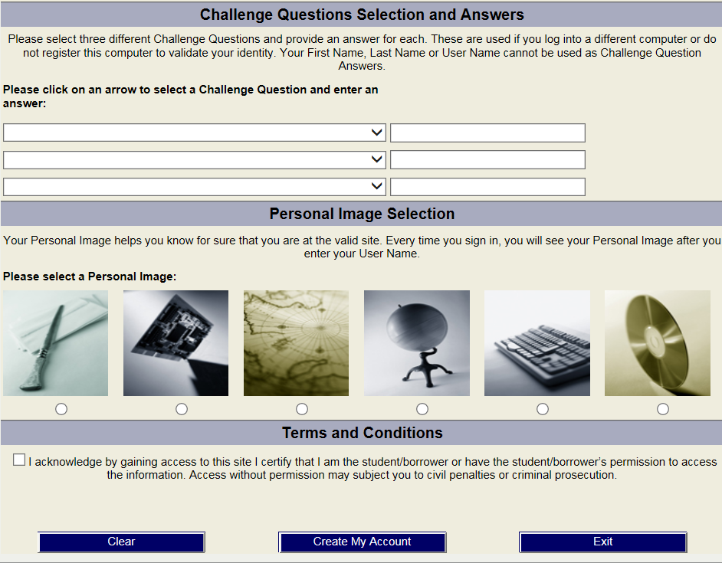
TN Promise Application Process
TSAC Student Portal

Slide 5
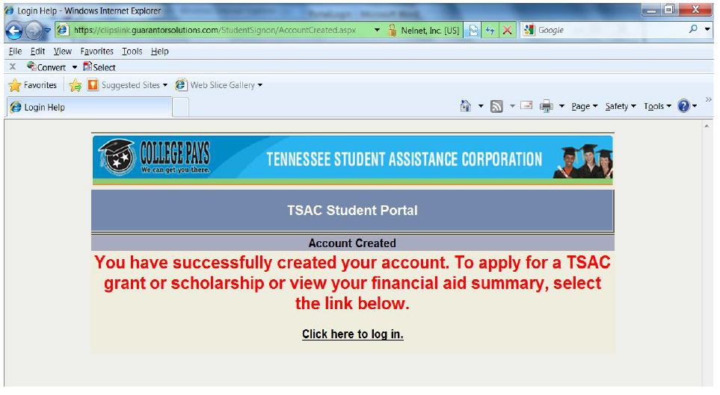
Tennessee Promise Application Portal
Click “Click here to log in.”

Slide 6
Tennessee Promise Application Portal
Enter the username created and click “Log In”.

Slide 7
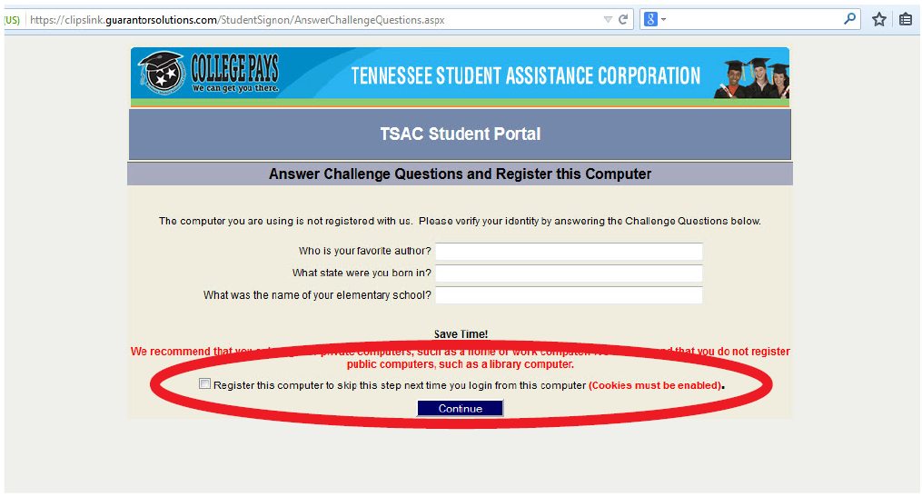
Tennessee Promise Application Portal
Answer your challenge questions and click “Continue”.

Slide 8
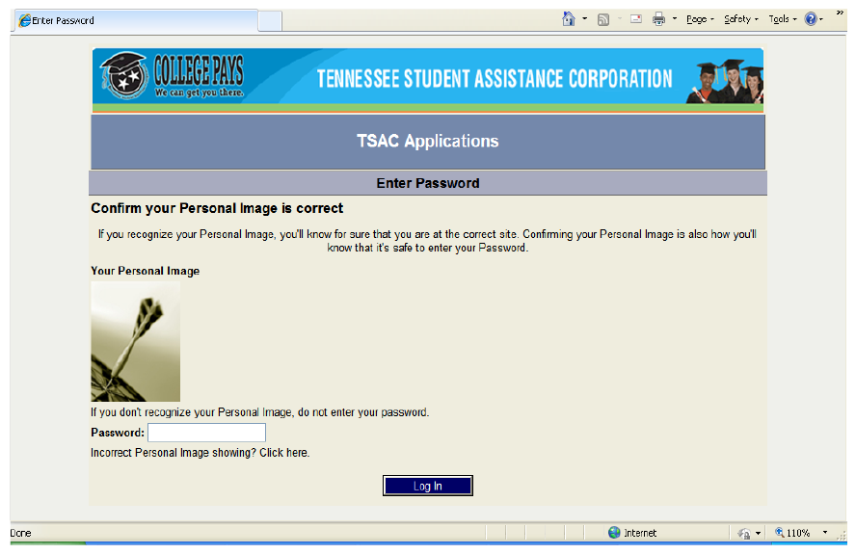
Tennessee Promise Application Portal
You will see the image you selected. Enter your password and click “Log In”.

Slide 9
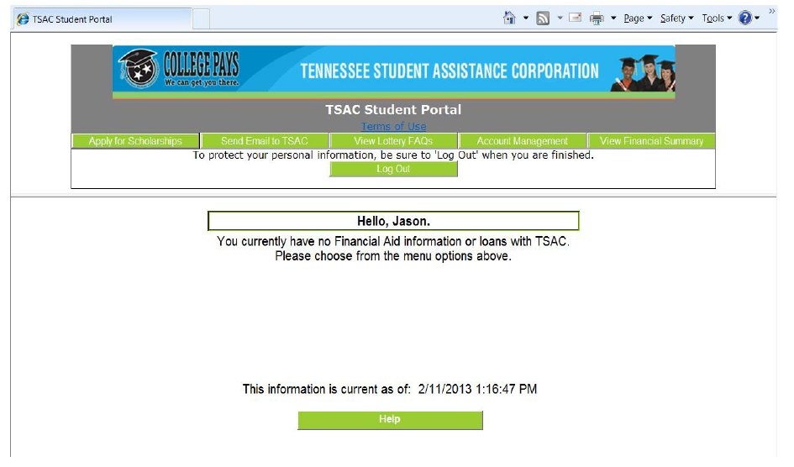
Tennessee Promise Application Portal
Click “Apply for Scholarships” to access online portal applications for Tennessee Promise and other scholarships.

Slide 10
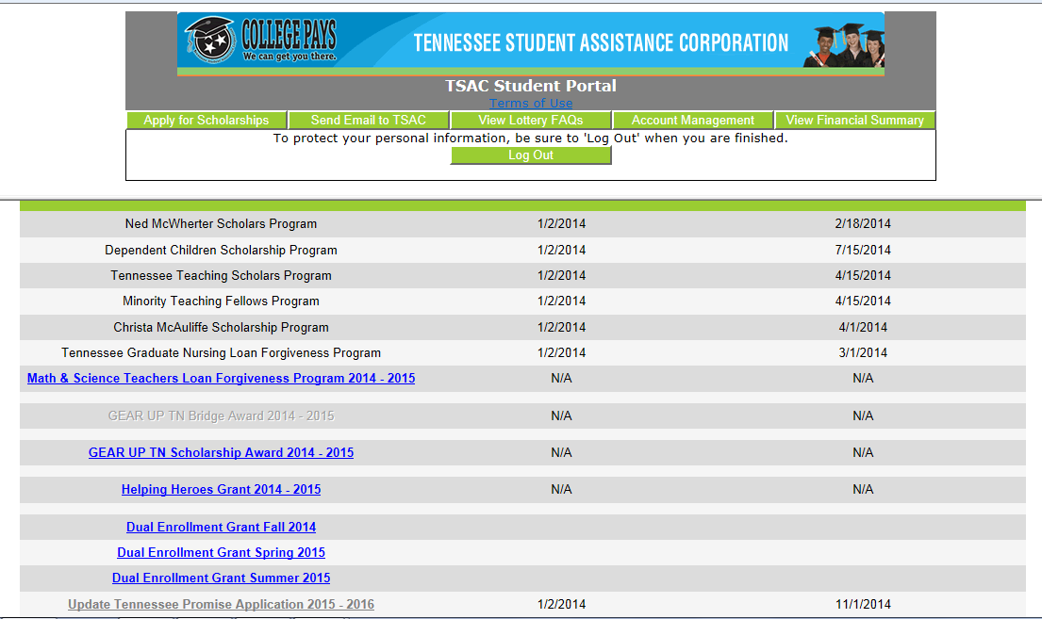
Tennessee Promise Application Portal
Scroll down page and click “Tennessee Promise Application”.

Slide 11
Tennessee Promise Application Portal
Click “I Agree” to proceed to the application.

Slide 12
TN Promise Application Process
TSAC Student Portal

Slide 13
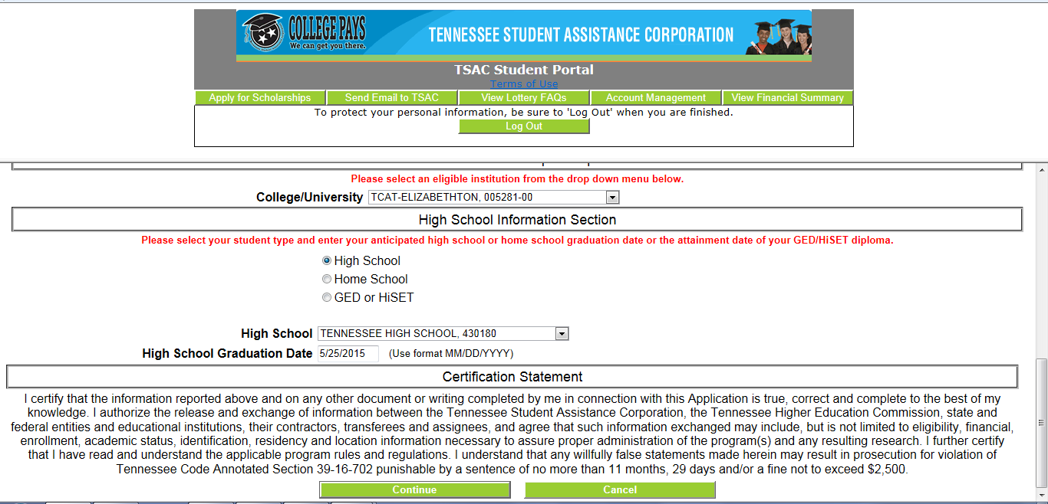
Tennessee Promise Application Portal
Answer several questions and click “Continue” to submit application.

Slide 14
Tennessee Promise Application Portal
Congratulations, you’ve successfully submitted your application. When you click “OK”, a PDF of the application will appear for you print/save for your records only. Please do NOT mail PDF to TSAC.

